Slide 1


CS-429 Introduction to Data Science
Information Retrieval
Page-Rank Algorithm
Mubashir Iqbal
Lecturer in Computer Science Department
HITEC University Taxila

Slide 2
Nature Language Processing
Information Retrieval

Slide 3
Basic Concepts

Slide 4
Basic Concepts
Letter (Alphabet)
Phonics
Word
Phrase
Clause
Sentence
Paragraph
Document

Slide 5
Basic Concepts
Letter (Alphabet)
Phonics
Word

Slide 6
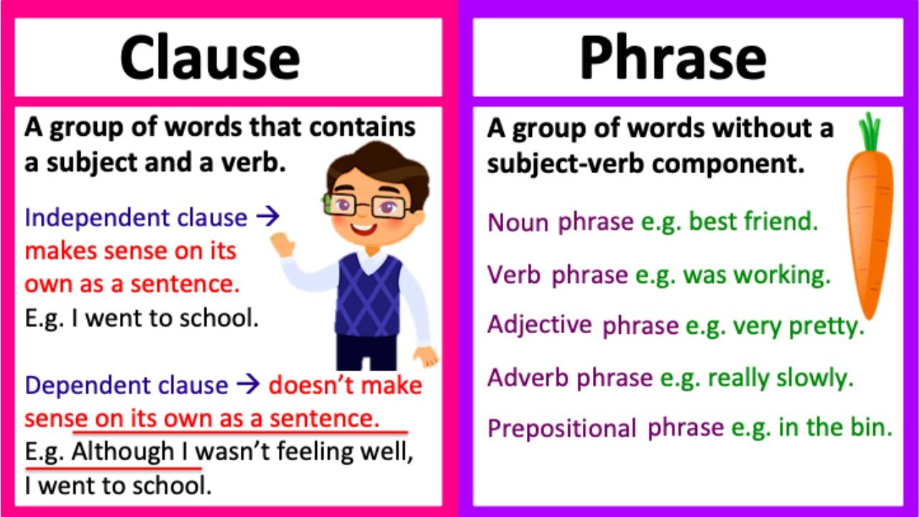
Basic Concepts
Phrase
Clause

Slide 7
Basic Concepts
Sentence

Slide 8
Basic Concepts
Sentence

Slide 9
NLP Terms and Concepts

Slide 10
Some Widely used Terms and Concepts
Token
Word
Lemma
Document
Vocabulary
Corpus
Dictionary
Lexicon
Morphology

Slide 11
Some Widely used Terms and Concepts
Token
Any thing which can be Word, Symbol, Sign, Expression, URL, EmotionIcon, Punnctuations, etc
Word
Smallest independent units of language
Usually referred to a meaning sequence of characters which is recognized and has a sense in any language
Can be in one Form or multiple forms (for Time/Tense)
New Words can be created based on existing concepts
Lemma
Base Word
Other words are usually based of this basic sequence of characters
Also called root/stem word

Slide 12
Some Widely used Terms and Concepts
Lemma
Base Word
Other words are usually based of this basic sequence of characters
Also called root/stem word
Document
The document refers to a body of text.
A collection of documents make up a corpus.
Like a product review, an email, Letter, Research Article

Slide 13
Some Widely used Terms and Concepts
Vocabulary
Vocabulary (from the Latin for "name," also called wordstock, lexicon, and lexis) refers to all the words in a language that are understood by a particular person or group of people.
Corpus:
Corpus refers to a collection of texts
Corpus can be General or Domain Specific
Corpus can be Domain Specific: Medical, Sports,History
Domain Expert can also annotate Corpus
Source of Corpus can be: newspapers, novels, recipes, radio broadcasts to television shows, movies, and tweets

Slide 14
Some Widely used Terms and Concepts
Dictionary
In Normal language, Dictionary is a set of Vocabulary words with their meaning
In Program, Dictionary is Key- Value Pair
In Python:
Dictionaries are used to store data values in key:value pairs.
A dictionary is a collection which is ordered, changeable and do not allow duplicates
Dictionary /Corpus/Lexicons are interchangeably used terms

Slide 15
Some Widely used Terms and Concepts
Lexicons
A lexicon is a collection of information about the words of a language about their lexical categories to which they belong.
A lexicon is usually structured as a collection of lexical entries,
Part of Speech Tagging
From basic to Deep level
Sentiment Lexicon
Add work sense as Positive or Negative
Value of A Sense of Positive in a range (0-1 or 0-5, both positive and negative sense)

Slide 17
Some Widely used Terms and Concepts
Morphology
The term morphology is Greek
morph- meaning ‘shape, form’,
-ology which means ‘the study of something’.
Linguistically, it is the study of the structure (or shapes) of a word
study of the internal construction of words
Example\
“replacement,” which is composed of re-, “place,” and -ment,
“walked,” from the elements “walk” and -ed.

Slide 18
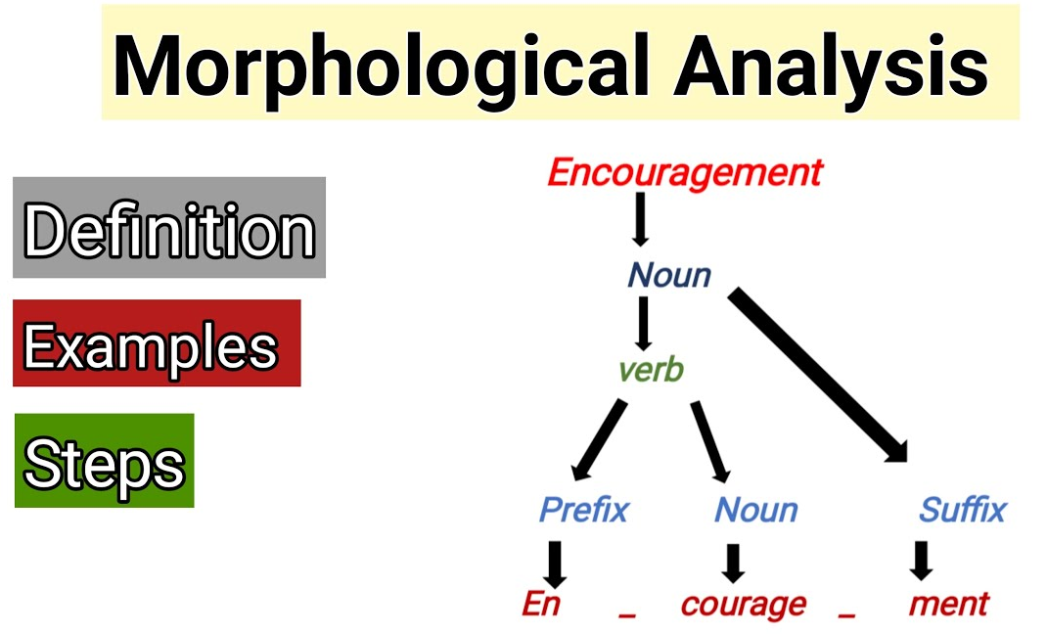
Some Widely used Terms and Concepts

Slide 19
Basic Concepts
Information Retrieval

Slide 20
Basic Concepts
Information Retrieval

Slide 21
Basic Steps of NLP Processing
Information Retrieval

Slide 22
Terminologies
Information Retrieval

Slide 23
Applications
Information Retrieval

Slide 24
Research Areas
Information Retrieval

Slide 25
Research Areas
Information Retrieval

Slide 26
Information Retrieval
Information Retrieval

Slide 27
Information Retrieval
Information Retrieval

Slide 28
Information Retrieval
Information Retrieval

Slide 29
Page Rank
PageRank is a link analysis algorithm developed by Larry Page and Sergey Brin, the founders of Google, to rank web pages in search engine results. It measures the importance of a webpage based on the quantity and quality of links pointing to it.

Slide 30
Information Retrieval
Information Retrieval

Slide 31
Information Retrieval
Information Retrieval

Slide 32


Slide 33


Not included in the Syllabus
Night-Life to Islam! – “Money & Girls, Nothing Made Me Happy”
Towards Eternity
URL: Night-Life to Islam! - "Money & Girls, Nothing Made Me Happy!" @Ibothepro
Duration: 00:28:51

